Slide 1

AUTOMATION
ENABLING
SERVICE
MAY 2023
Presented at Dev CoP

Slide 2

We are a team of highly skilled automation experts who are part of the TCOE team within Testing Services, Enterprise Digital Solutions, Innovation Information and Technology Branch (IITB).
OUR MISSION
To enable ESDC in adopting modern DevOps and test automation best practices.

Slide 3

MANDATE
Coach, mentor, and enable teams to empower them to use modern best practices for Agile, DevOps and test automation. We provide software development training, teach automation best practices, and provide support for whatever the team needs to succeed.

Slide 4

GUIDING PRINCIPLES
That is Always Our Job
We never say, “that’s not our job.” We help teams in any way we can to enable them to learn and use DevOps testing practices. This includes not only working with them to help them learn, but also reaching out and working with other teams needed to remove any roadblocks to their success.
Continuous Learning
We constantly learn and adapt our methods, both based on what works and what does not with the teams we are enabling, as well as keeping apprised of industry best practices.
Trust Our People
Our employees at ESDC are intelligent, dedicated people. Any of them are capable of learning from our automation enabling program, and we trust that they will be able to achieve success with our program, regardless of their level of prior knowledge of software development and other key skills.
One Step at a Time
Enabling ESDC to use best practices in software testing is a big job. Instead of trying to get us there in one jump, we are constantly looking for any incremental steps that will take us forward, no matter how small.
Perfect is the Enemy of Good
Our systems at ESDC are large, contain many moving parts, and many of them have been around for decades. Instead of demanding that any changes we suggest be the ideal best practice right away, we look for what we can do right now to improve things.
Infinite Mindset versus Finite Mindset
A finite mindset views situations as either win or lose, as though there is a scorecard. An infinite mindset is grateful, builds relationships, and works toward a common good. We apply the infinite mindset to our team to ensure we can best enable change at ESDC.

Slide 5

OUR GOALS
Modernize ESDC's approach to Quality Assurance
Upskill employees in modern testing practices by increasing their technical knowledge and coding skills
Build quality into applications while significantly shortening testing cycle times
Help transition ESDC to a DevOps model of application development by Shifting Left with pipeline integration
Promote collaboration and tear down silos in application development

Slide 6
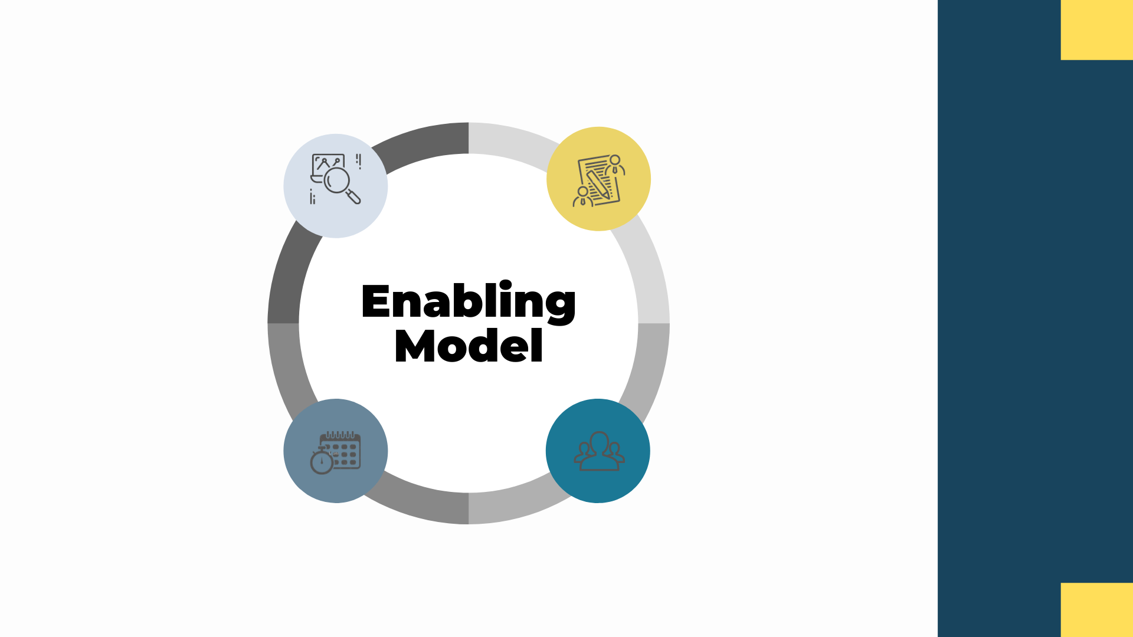
Phase One:
Learning
Phase Two:
Workshops
Phase Four:
Continuous Improvements
Phase Three:
Mentoring

Slide 7

PHASE ONE: LEARNING
15 WEEKS
During this phase, teams work through an online training curriculum that is tailored to the individual needs of the team.
Typical learning includes;
Intro to Programming
DevOps Concepts
C# or Java, Git
The enabling coach meets with the team twice a week throughout this phase to check in on learning progress and answer questions. Learners are expected to dedicate a minimum of 4 hours per week to their learning (2 hours with their enabling coach and 2 hours of self-learning).

Slide 8

PHASE TWO: WORKSHOP
10 WEEKS
During this phase, teams meet with their enabling coach two times per week to collaboratively work through coding workshops to further develop the skills required for test automation.
Hello World
My First Test Project
My First Selenium Project
Functional Test Project
Web Driver Extensions
Page Object Model
Pipelines
Portion Model

Slide 9
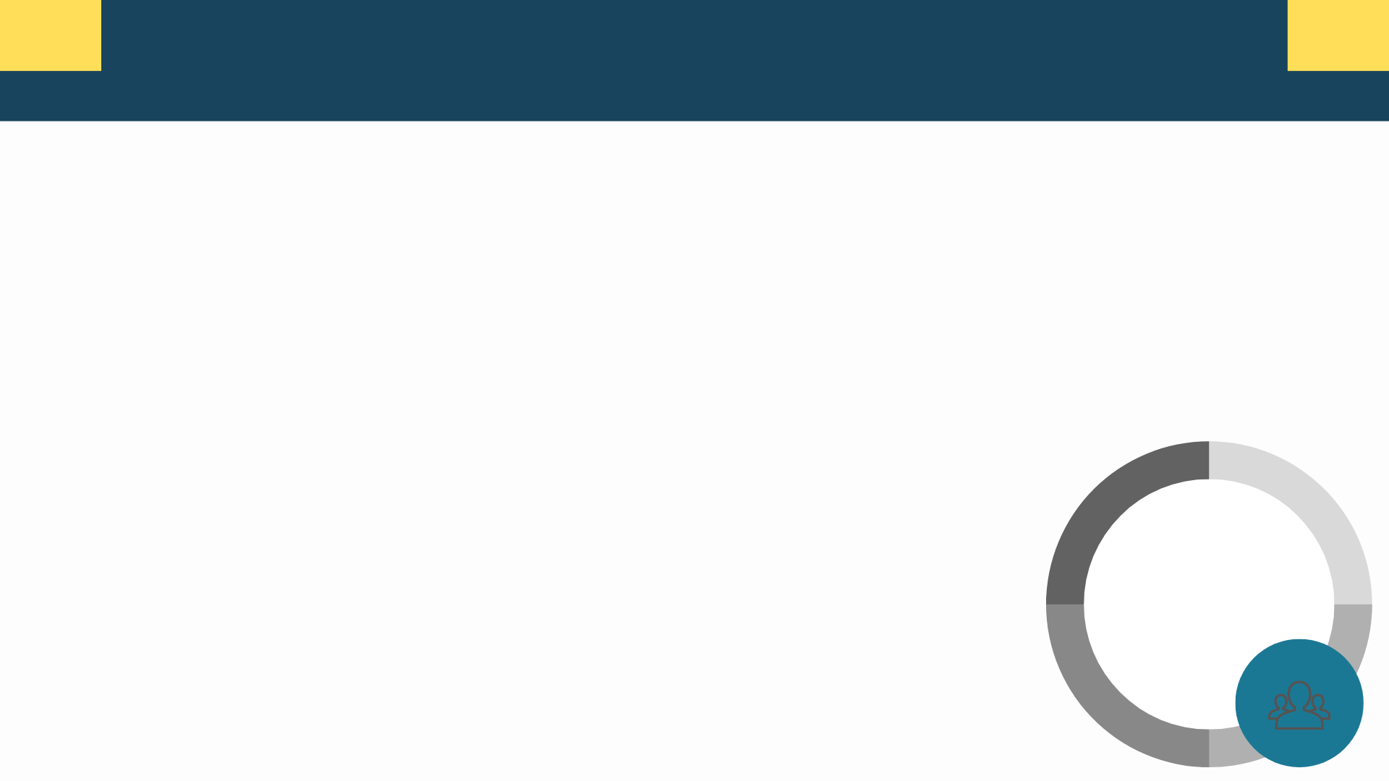
At this point in the process, the enabling coach sets up the DevOps infrastructure pipeline for test automation.
The team starts to code automated test cases and execute them in their pipeline.
Twice a week the team participates in code reviews; reviewing pull requests and performing peer reviews on code.
The enabling coach offers advice on best practices and helps troubleshoot any technical issues.
2 + MONTHS
PHASE THREE: MENTORING

Slide 10

At this point in our model, teams are successfully coding automated test cases that are passing peer review without error. The enabling coach pulls back, the team becomes autonomous, and we consider the team 'Graduated'.
During this phase, we continue to offer support through;
Spot checks on Peer Review and Releases
Ongoing support through Teams, email, or coaching
Monthly Graduates Check-in Meeting
Technical troubleshooting and help with refactoring as needed
CONTINUOUS
Demo new technologies and practices
PHASE FOUR: CONTINUOUS IMPROVEMENTS

Slide 11

ACCOMPLISHMENTS
As of January 1st, 2023, we have;
Successfully enabled 15 testing teams and 6 development teams who have reached Graduate Status of our Enabling Model
Currently coaching and mentoring 12 additional application teams who are at various stages of our Model
Set-up and integrated test automation in 22 Azure DevOps pipelines using Git
Upskilled 66 employees to increase their technical knowledge and coding skills

Slide 12
Testing Centre of Expertise
What’s new?
2022-2023

Slide 13


Updates to our Test Automation Workshop
We’re continuously updating our Test Automation Workshop for Web Applications. This year we have closed off Phase 1 of our training package.
Several exercises have been updated based on feedback from clients and enablers
Test Automation Framework has been bundled and made available on NuGet (CSharpSeleniumTemplate)
Makes versioning and updates more easy to manage
No need to copy TCOE code into various ESDC test solutions
Easy to retro fit for existing non-NuGet implementations

Slide 14

Test Automation for Desktop Applications
TCOE has had great success with its enabling service for test automation of web applications. We are looking to expand this model to other development platforms used at ESDC, starting with desktop applications.
The team has researched test automation frameworks for desktop applications, mainly the FlaUI and Appium libraries.
Appium Extends Selenium Supports mobile apps (IOS, Android) Dependency on WinAppDriver Requires admin rights | FlaUi No dependencies Does not require admin rights Built in locators

Slide 15


Test Automation for Desktop Applications
Test Automation Workshop for Desktop Applications is currently being developed by the Test Automation Enabling Team using FlaUI.
It follows the same structure as our existing Test Automation Workshop for Web
Suitable for all levels of programming experience
Self Learning component, then workshop sessions with an enabler
Workshop consists of 8 modules, complete at your own pace
Enablers will help setup automation with the graduate’s application
Full support and mentoring after graduation
Target Availability is Fall 2023

Slide 16

Open Source
We have begun working on opening up our enabling packages as open source software, with the goal of hosting on GitHub.
Working with The IP Centre of Excellence (IPCOE) for this project
Current challenges include:
Combining our repositories to be opened up into one repository
Making all our packages work in the cloud
Picking a software license
If your team has had experience with making your application open source we would love to hear about it, please reach out to Joshua Hillerup (Hillerup, Joshua J [NC]) on Teams.

Slide 17


Automated Performance Testing
Our team is researching automation of Performance Testing. We are currently looking into JMeter integration in ADO Pipelines, and its required infrastructure and configuration to work with build agents.
JMeter is able to perform Load Testing, Stress Testing, Soak Testing, among others.
Compatible with web applications, desktop applications, web APIs, web services, and others.

Slide 18


Integrating Testers in Solution Development Teams
Over the past year, we have piloted an integrated approach to testing, by embedding testers in existing business solutions development teams.
WHY?
Our current model, which segregates teams by function, has many constraints and challenges that impact our ability to deliver quality software solutions
Moves us towards a DevOps approach to solutions development, which aligns with IITB strategic priority to deliver IM/IT services at higher velocity and quality through the adoption of modern ways of working
We have received very positive feedback on this integrated approach to testing;
Better communication, sharing of information
Smoother/seamless workflow
Increased knowledge, cross functional workforce
Found efficiencies – processes and resources
Looking to implement pilots with additional teams to adopt this integrated solution development approach.
Development
Testing

Slide 19
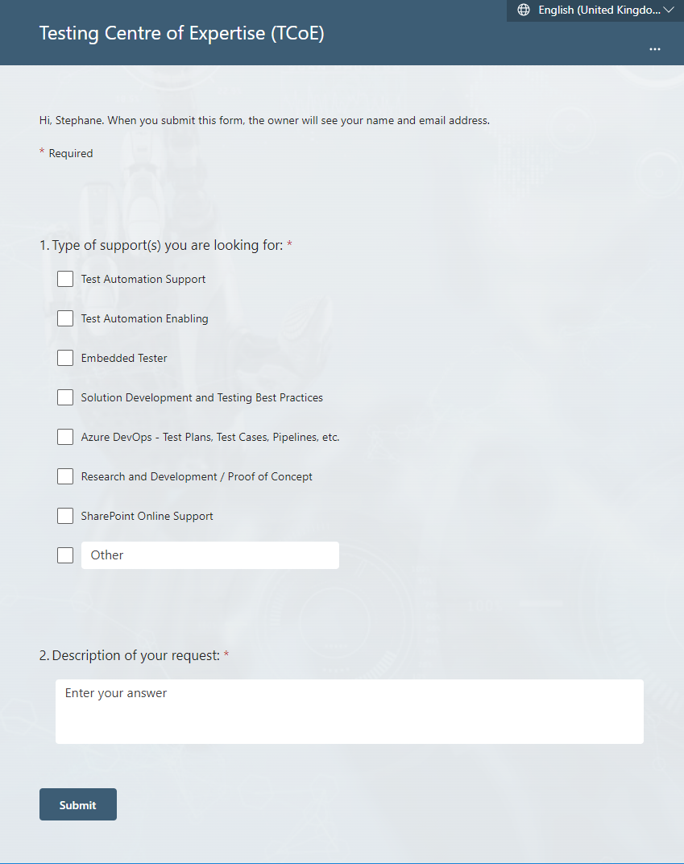
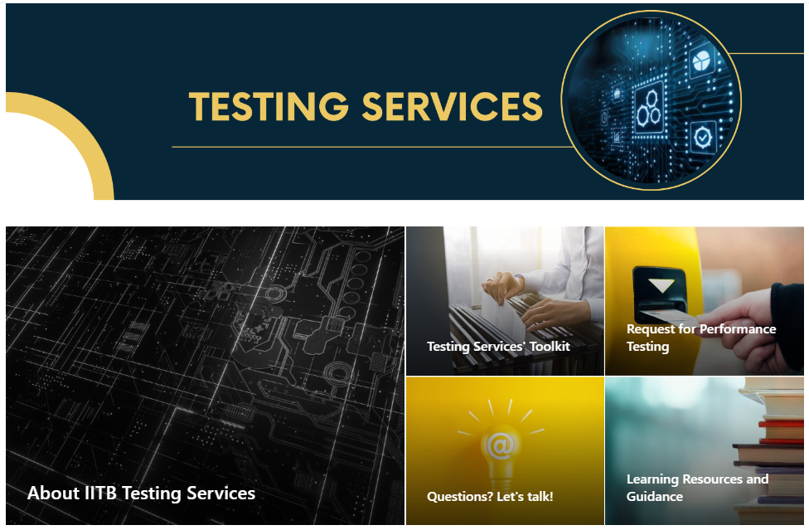
New TCOE Service Request Form
For any enquiries, visit our Sharepoint Site
https://014gc.sharepoint.com/sites/DGIIT-SME_IITB-TS
Fill out the new TCOE Service Request Form

Slide 20

If you would like to take the quality of your software solution to the next level, reach out, we would be happy to add you to our list of collaborators.
EMAIL
NC-SYS-TCOE-CEME-AUTOMATION-GD
SERVICE REQUEST INTAKE FORM
Testing Centre of Expertise (TCoE) (office.com)
SHAREPOINT
Testing Centre of Expertise - Home (sharepoint.com)

